Slide 1
BIG MART SALES ANALYSIS

Slide 2
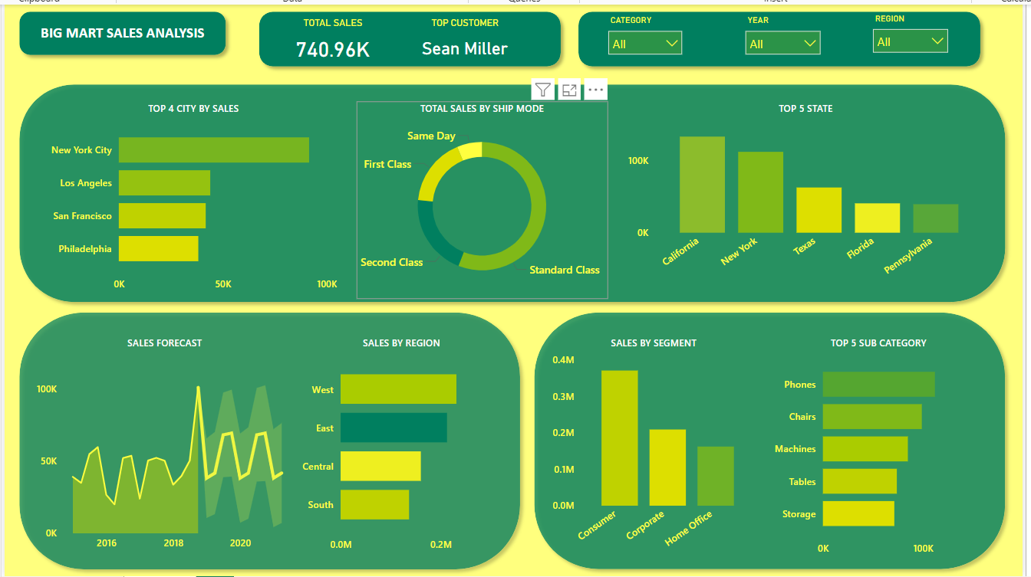

Slide 3
OBSERVATION
Total Sales Overview :
Total Sales ( 740.96k) : This figure represents the overall sales performance across all categories ,regions and years . This magnitude of this number suggest a broad customer base and diversified sales channel .
Top Customer (Sean Miller) : Sean Miller emerges as the top customer indicating either a high volume of purchases or frequent transactions . It would be beneficial to analyze this customers purchase history to identify what drives their loyalty or purchasing behavior .
2. Top City By Sales :
New York City : The sales in New York City exceeds 100k , making it the most lucrative market . Considering the population density and economic activity in New York , it should be strategic to continue focusing marketing efforts here . Expanding the product range or enhancing delivery options could further capitalize on this market .
Los Angeles : The second largest market LA ,given its size ,there may still be untapped potential . Assessing customer demographics and their preferences could uncover opportunities for increased market penetration .

Slide 4
San Francisco , Philadelphia : Both cities are promising sales figures but lag behind New York and LA . These cities could benefit from targeted promotions ,especially in subcategories that perform well in these regions .
The concentration of sales in these four cities suggests that urban markets are a significant driver of revenue. Expanding services or creating exclusive offers for customers in these cities could further strengthen sales .
3. Sales By Shipping Mode :
Standard Class : This is the most dominant class of shipping . This may be due to the cost effectiveness for customers .
However , given its importance , ensuring that the standard class service is crucial and fast is crucial in maintaining the customer satisfaction .
First Class : This option , though less utilized ,indicates a segment of customers willing to pay more for faster shipping .Targeting these customers with premium offers or expedited services could enhance their shopping experience .
Second class : Though like the first class but this class could be bolstered by improving its cost value proposition .
Same day shipping : This could indicate that customers either find the costs too high or the need for urgent deliveries is rare . However , promoting the benefits of Same Day shipping for last minute shoppers or urgent needs could increase its uptake .

Slide 5
4. Top States By Sales :
California : Leads significantly in state wise sales ,driven by the strong performance in cities like San Francisco and LA . Given California’s economic strength , further tailoring marketing campaigns to suit local preferences and leveraging statewide events could be beneficial .
New York : Following California , New York’s sales are robust . The majority of sales likely come from New York city , but exploring upstate regions could open new opportunities .
Texas : Texas shows potential as an emerging market. With large urban centers like Houston and Dallas, regional campaigns that focus on local culture and preferences could further boost sales.
Florida : A steady performer, but with room for growth. Florida’s diverse population and economic activities suggest potential in niche markets or seasonal promotions.
Pennsylvania : Rounding out the top five, Pennsylvania’s sales suggest a stable but underdeveloped market. Identifying key cities or segments within the state for targeted campaigns could enhance performance.

Slide 6
5. Sales forecast :
Sales peak in 2018 : The spike around 2018 could be due to significant event, product launch, or promotional campaign. Analyzing what drove this peak could provide insights for replicating similar success in the future.
Volatility post 2018 : The sales figures show fluctuations, possibly indicating market instability or seasonal variations. Predictive analytics could be employed to smoothen this volatility by anticipating low seasons and launching preemptive promotions.
Sales drop post 2020 : In the line chart under "Sales Forecast," there’s a visible dip in sales post-2020. This suggests that the company experienced a decline in sales during this period. The line chart should be closely examined to identify the exact periods (months/quarters) when the decline started, reached its lowest point, and began recovering . External factors such as covid during 2020 might have been the reason for the downfall of sals during this period . Specific industries were hit harder than others (e.g., retail, travel), which could have influenced sales for products or categories more reliant on those industries . The pandemic led to delays in manufacturing and shipping, causing stockouts and delayed deliveries, which could have impacted sales . The dashboard shows sales by region (West, East, Central, South). You could drill down into this data to see which regions experienced the most significant sales declines. This can help determine if the dip was widespread or isolated to specific regions.
The "Sales by Segment" visualization breaks down sales by Consumer, Corporate, and Home Office segments. Understanding which segment experienced the largest decline could provide insights into customer behavior post
2020 .

Slide 7
6. Sales By Region :
West Region : Driven by California, the West region is the top-performing area. This region likely benefits from strong urban centers, a tech-savvy population, and higher disposable incomes. Continuously innovating and staying ahead of competitors in this market is key.
East Region : The East follows closely behind, likely driven by New York. Expanding into other Eastern cities like Boston or Washington, D.C., might help close the gap with the West.
Central Region :The Central region shows moderate sales. Given the geographic spread, focusing on regional hubs like Chicago or Detroit with specialized campaigns could enhance performance.
South Region : The South lags, which may be due to less urbanization or different consumer behavior. Conducting market research to understand customer preferences in the South and adapting offerings accordingly could drive growth.
7. Sales By Segment :
Consumer Segment : By far the largest segment, suggesting that individual consumers make up the bulk of sales. Ensuring a positive shopping experience, including ease of use on platforms and customer service, will be crucial for retaining and growing this base.

Slide 8
Corporate Segment : A significant portion of sales comes from businesses. Offering business-centric products or bulk purchasing options could further solidify relationships with corporate clients.
Home Office Segment : The smallest but still noteworthy, this segment may have seen growth during remote work periods. Continuing to cater to home office needs (e.g., ergonomic furniture, tech accessories) could maintain this segment’s relevance.
8. Top 5 Sub categories By Sales :
Phones : Leading the sub-categories, Phones are likely a key product driving sales. Ensuring availability and offering the latest models could keep this sub-category at the top.
Chairs and Machines : Both categories are significant contributors, possibly reflecting office furniture and tech equipment demand. Promoting ergonomic designs and high-efficiency machines could boost sales.
Tables and Storage : These categories, while performing well, could see increased sales with targeted promotions, bundling with related products, or highlighting versatility and space-saving features.

Slide 9
STRATEGIC RECOMMENDATIONS :
Geographical Expansion : Given the concentration of sales in a few states and cities, exploring secondary markets within those states or expanding to nearby states could uncover new opportunities.
Shipping Optimization : Since Standard Class dominates, optimizing this service for cost and reliability will be key. Encouraging the use of Same Day or First Class through targeted promotions could diversify shipping choices and increase revenue from these modes .
Product Focus : Strengthening the product portfolio in the most popular sub-categories (Phones, Chairs, Machines) while exploring customer needs in lesser-performing categories could create balanced growth .
Customer Segmentation : With a large consumer segment and a growing corporate base, segmenting marketing efforts to cater specifically to each group’s needs (e.g., personalized offers, bulk discounts) could enhance customer loyalty and sales.

Slide 10
BIG MART SALES ANALYSIS
The End !!!

